Slide 1



Yale School of Art
< Website
Analytical
Evaluation >
João Vieira - 50458
Lara Matos - 95228
Vítor Santos - 107186

Slide 2

Table of Contents
1 Introduction
2 Motivation
3 Methodology
4 Issues found
5 Heuristic
Evaluation
6 Cognitive
Walkthrough
7 Appreciation
& Solutions
8 A Good
example

Slide 3
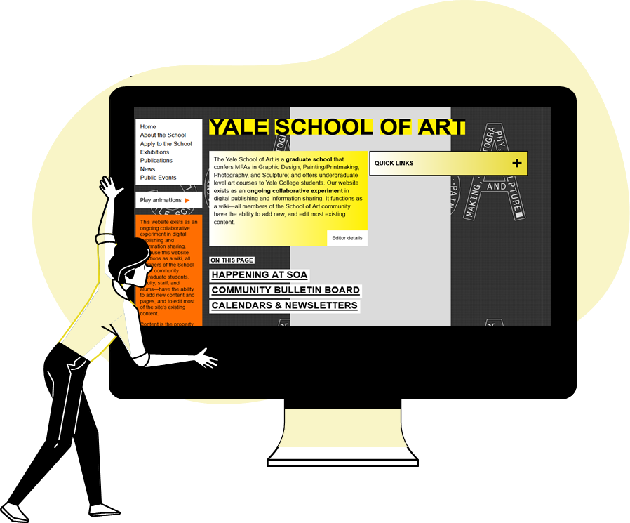
Introduction
Yale School of Art:
Graduate school website
Event & News publication platform
General institutional information
Any student or staff can edit

Slide 4

Why this choice?
A good alternative
#2 on Graphics Design
Artistic expression Vs Usability
A well-known good, bad example

Slide 5
Methodology - Analytical
Heuristic Evaluation
(Independent evaluators to prevent bias)
Cognitive Walkthrough
(Group activity)

Slide 6

Number of Issues found
Vítor
Lara
João
Issues
28
1

Slide 7
Number of Issues found
Issues ID | Description
1 | Last editor instead of "Editor Details"
2 | Menu "Quick Links" has different types of letters with no apparent reason
3 | Unnecessary "Play Animations" button on some subpages
4 | Slow website when passing between subpages
5 | Irrelevant website icon
6 | Address information isn't aggregated in contact information
7 | Some hyperlinks aren't obvious
8 | Font letter too small
9 | Navbar position in an odd position
10 | "About" of the website should be in the navbar explaining context
11 | There are two calendars on the mainpage and repeated calendars
12 | Badly configured titles / lack of care
13 | News too long, should have a "See more" button to redirect
14 | There is no standard for widget and publication style
15 | Login button visibly associated with page editing utilities
16 | Requires time-consuming searching of the links menu depending on page depth
17 | News from New Haven archive too difficult to navigate
18 | "Quick Links" menus change between pages and don't appear on sone subpages
19 | In "Quick Links" the existence of "Newsletter & Calendars" doens't make sense
20 | There is no direct correlation between Android and Browser PC designs
21 | Excessively concentrated information the the left part of the screen
22 | Missing identifications icons for functions and tasks
23 | Visiting sections doesn't link Visiting page / Link is in different section
24 | Homepage doesn't look like a Homepage. Total disorganization
25 | Chaotic Navbar
26 | Excessive on-screen content
27 | When trying to login as a visitor it doesn't allow to enter, register and doesn't give an email error directly
28 | Poor login UI

Slide 8

Severity classification
Issues ID | João | Lara | Vítor | Median
1 | 0 | 1 | 0 | 0
2 | 1 | 1 | 1 | 1
3 | 1 | 1 | 1 | 1
4 | 2 | 1 | 1 | 1
5 | 0 | 1 | 2 | 1
6 | 2 | 1 | 1 | 1
7 | 1 | 1 | 1 | 1
8 | 3 | 1 | 2 | 2
9 | 2 | 2 | 2 | 2
10 | 2 | 2 | 2 | 2
11 | 2 | 3 | 2 | 2
12 | 2 | 1 | 2 | 2
13 | 1 | 2 | 2 | 2
14 | 3 | 2 | 2 | 2
15 | 3 | 2 | 2 | 2
16 | 3 | 2 | 2 | 2
17 | 2 | 2 | 3 | 2
18 | 2 | 3 | 3 | 3
19 | 3 | 3 | 2 | 3
20 | 3 | 3 | 3 | 3
21 | 3 | 4 | 2 | 3
22 | 3 | 3 | 2 | 3
23 | 3 | 2 | 3 | 3
24 | 4 | 4 | 3 | 4
25 | 4 | 4 | 3 | 4
26 | 3 | 4 | 4 | 4
27 | 4 | 4 | 3 | 4
28 | 4 | 4 | 3 | 4
Lets focus on Issues 18 to 28!
(Severity Level 3 and 4)

Slide 9
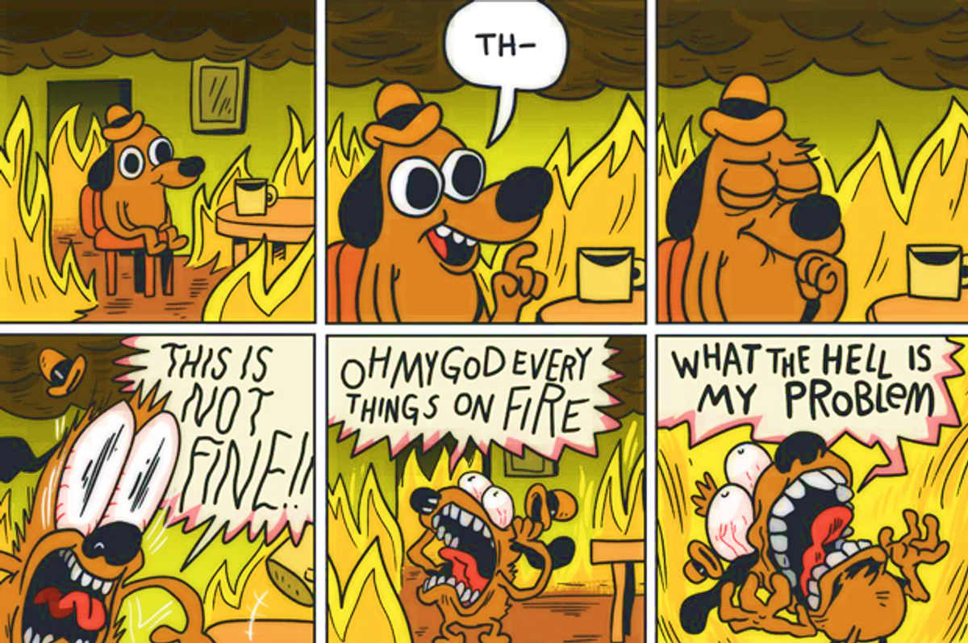
Focus
Issues ID | João | Lara | Vítor | Median
18 | 2 | 3 | 3 | 3
19 | 3 | 3 | 2 | 3
20 | 3 | 3 | 3 | 3
21 | 3 | 4 | 2 | 3
22 | 3 | 3 | 2 | 3
23 | 3 | 2 | 3 | 3
24 | 4 | 4 | 3 | 4
25 | 4 | 4 | 3 | 4
26 | 3 | 4 | 4 | 4
27 | 4 | 4 | 3 | 4
28 | 4 | 4 | 3 | 4

Slide 10
Heuristic Evaluation
10 Nielsen’s Heuristics:
Status Visibility
Match System & Real World
Control & freedom
Consistency and Standards
Error prevention
Recognition > Recall
Flexibility
Minimalism
Recognize, Diagnose and Recover
Help and Documentation
Issues ID | João | Lara | Vitor | Median
24 | 4 | 4 | 3 | 4
25 | 4 | 4 | 3 | 4
26 | 3 | 4 | 4 | 4
27 | 4 | 4 | 3 | 4
28 | 4 | 4 | 3 | 4

Slide 11
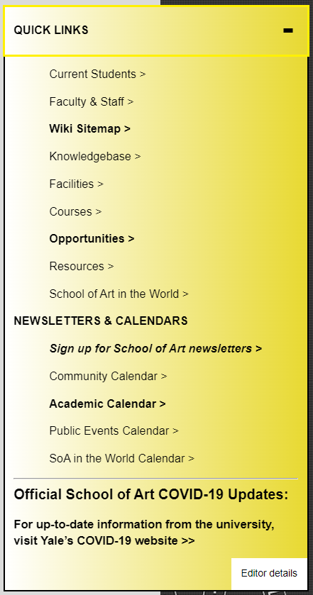
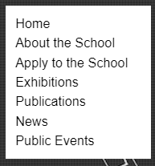
Heuristic Evaluation
Issue ID 25: Chaotic Navbar
Description: Mainpage has 2 different menus for navigation
Heuristic set violations:​
Poor flexibility​
Hardly recognizable​
No consistency
Severity: 4

Slide 12

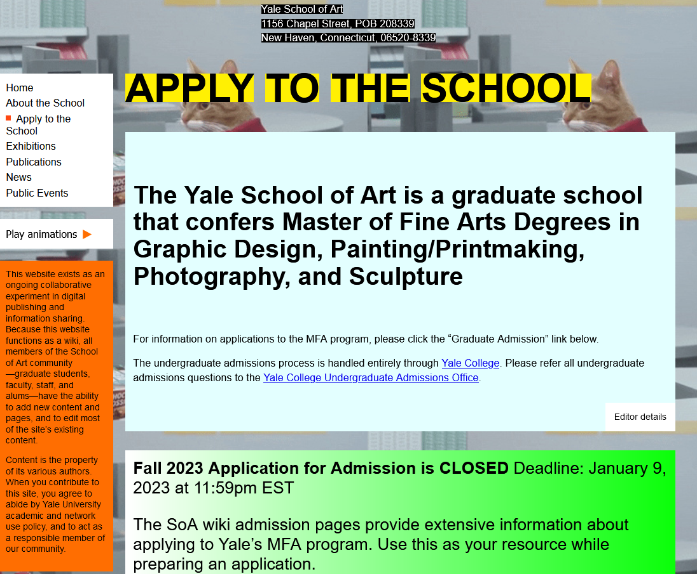
Heuristic Evaluation
Issue ID 26: Excessive on-screen content
Description:
Illegible aesthetic
Heuristic Set violation:
Absent minimalism
Consistency and standard
Error prevention
Recognition
Severity: 4

Slide 13
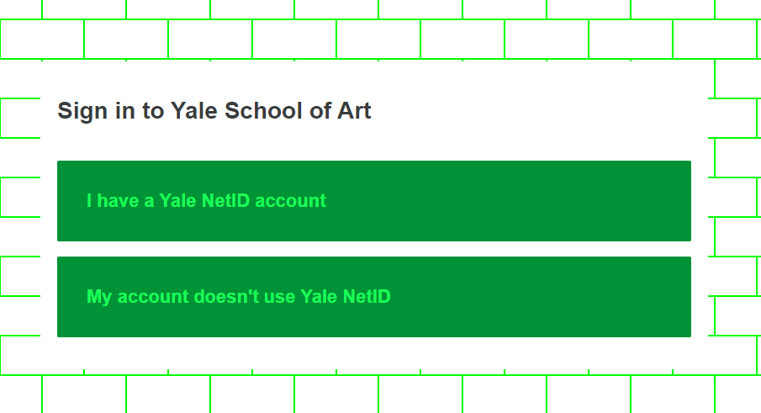
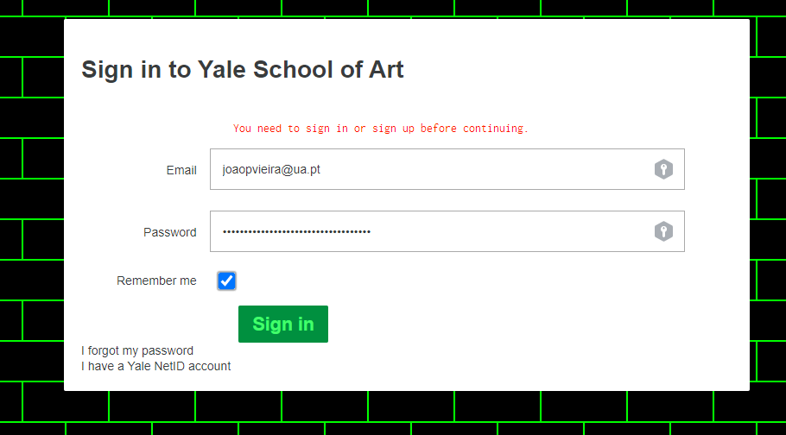
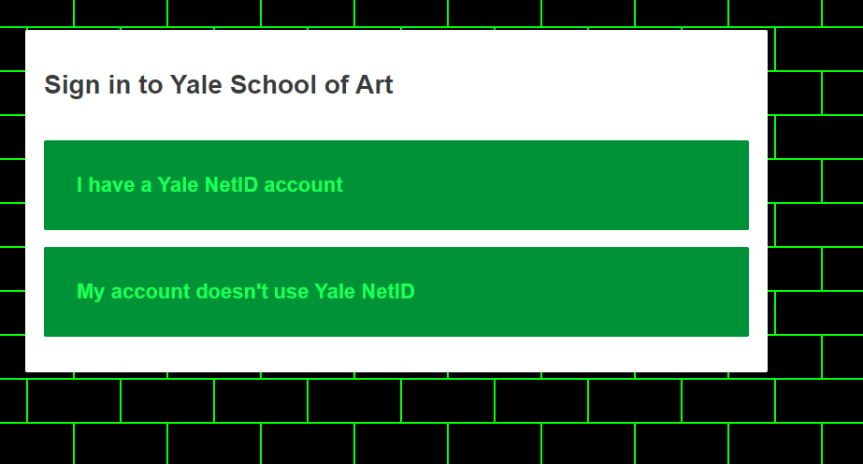
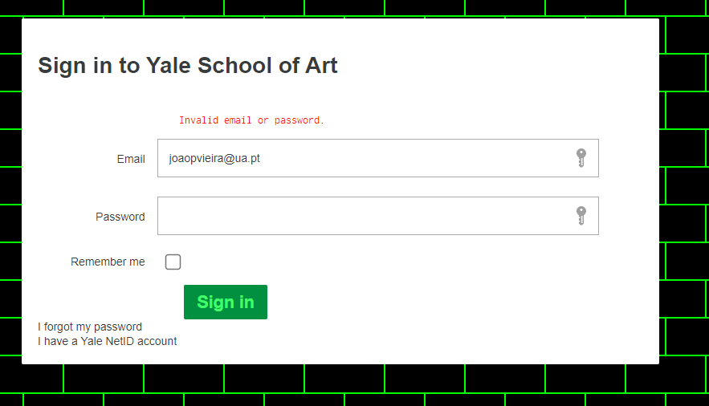

Heuristic Evaluation
Issue ID 28: Poor login UI
Description:
No return button
Incorrect order of validation
Heuristic Set violation:
Error prevention
Help users recognize, diagnose and recover for errors
Severity: 4

Slide 14
Cognitive Walkthrough
Task: Look for weekly events / news during the week of 23th March 2020
Target users: Any staff, teachers or students of the SOA
Actions identified in the task:
Go to the mainpage and access “News”
Access “Letter Archive”
Select Week at SOA
Refresh the page (F5)
Scroll down to the requested date
Streamlined Cognitive Walkthrough (Spencer, 2000)
Q1: Will the user know what to do at this step?
Q2: If the user does the right thing, will they know that did the right thing, and are making progress towards their goal?
w

Slide 15
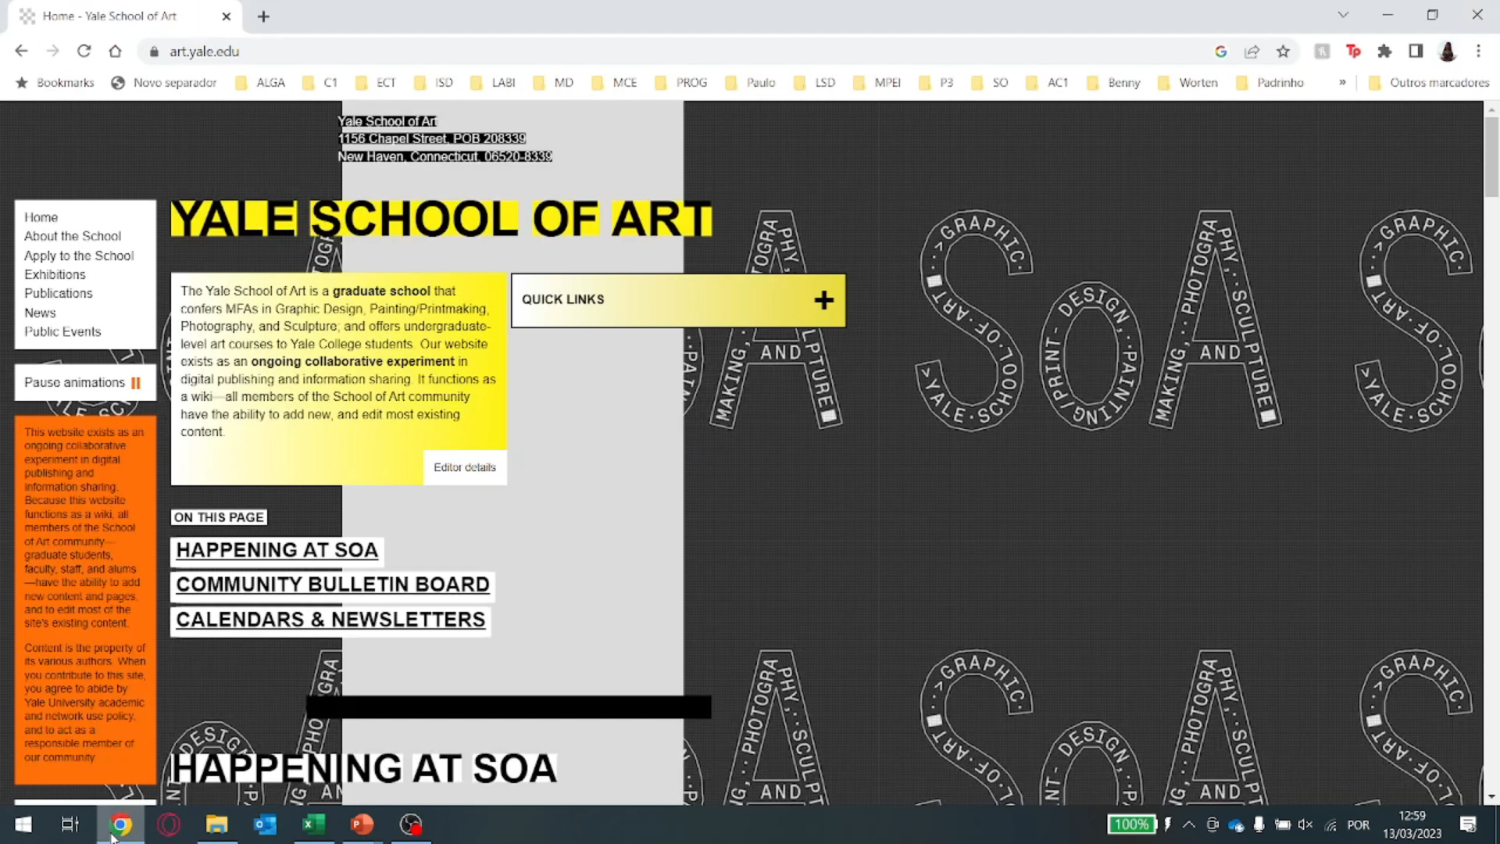

Slide 16
Answering Questions - Tasks
1.) Go to the mainpage and access “News”
Q1: Probably yes, but its confusing.
Q2: Probably yes
2.) Access “Letter Archive”
Q1: Probably no.
Q2: Probably no
3.) Select Week at SOA
Q1: Probably no.
Q2: Probably no.
4.) Refresh the page (F5)
Q1: DEFINATLY NO!
Q2: DEFINATLY NO!
5.) Scroll down to the requested date
Q1: Yes but it’s boring!
Q2: Yes.

Slide 17
Overall appreciation
Art is subjective and complex
Artistic expression can be applied in Usability
Website is a deterrent for regular users
Is not good for a “#2 College” for Graphics design.
Everyone can edit everything = Bad Idea
Not very secure.
Security
Usability
Interface

Slide 18
Solutions
Website art gallery
People can only edit in specific areas
(personal gallery space)
3. Collaboration between Engineers and Artists

Slide 19
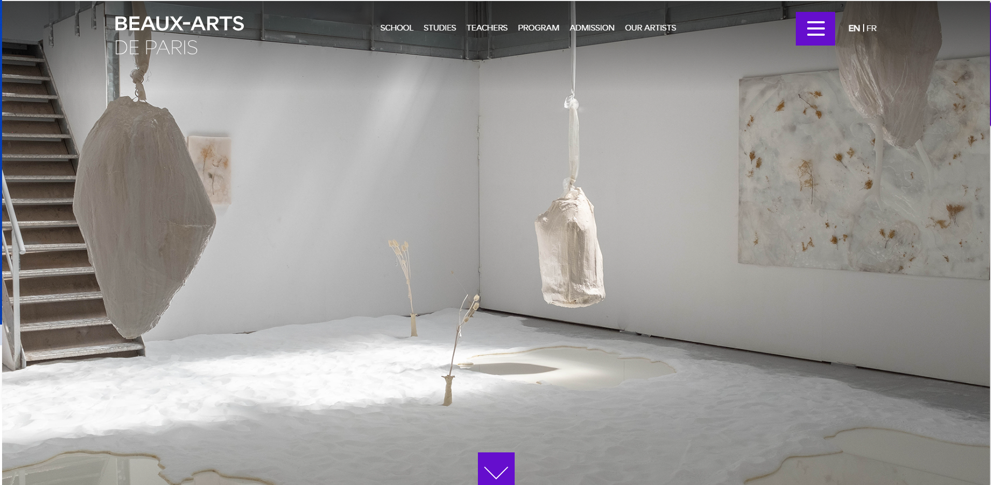
A Good Example
National School of Fine Arts - Paris, France

Slide 20
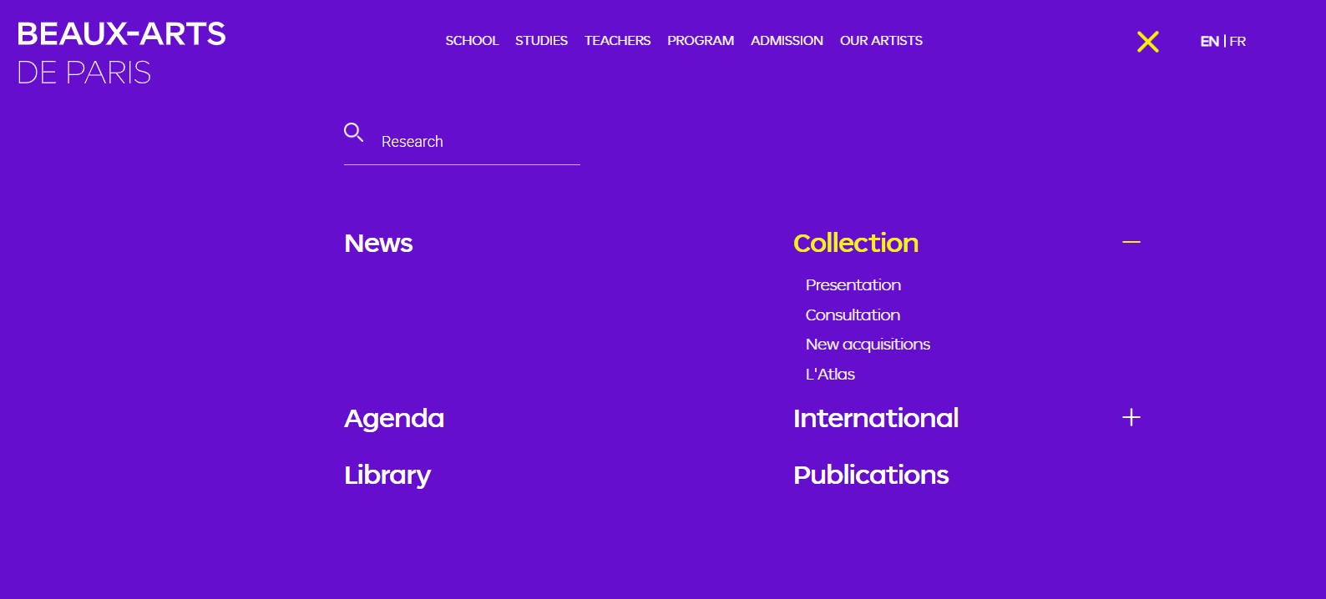
A Good Example

Slide 21
Thank you

